Slide 1
Basics of Digital Logic Design
Mainak Chaudhuri
Indian Institute of Technology Kanpur

Slide 2
Sketch
Combinational logic
Sequential logic
Field programmable gate array
Asynchronous inputs
Static random access memory (SRAM)
Dynamic random access memory (DRAM)
Finite state machines

Slide 3
Combinational logic
No memory for remembering state
Usually always enabled
Some important combinational logic units
Decoders
Multiplexors
Encoders
Priority encoders
Comparators
Any combinational logic can be designed using AND, OR, and NOT gates
CMOS: NAND, NOR, and NOT gates

Slide 4
Combinational logic
Two-level logic implementation
Any combinational logic can be designed by having an array of AND gates in first level, an array of OR gates in the second level, and an optional NOT to get the output
Sum of product (SoP) representation; sum of minterms
First level OR and next level AND
Product of sum (PoS) representation; product of maxterms
SoP and PoS representations follow directly from the truth table
Example: full adder

Slide 5
Combinational logic
Programmable logic array (PLA)
Another name for SoP implementation
AND plane and OR plane
Size of the planes?
Dot representation
Implementing Boolean functions in ROM
Read only memory
PROM and EEPROM variants
Number of rows is exponential in number of inputs
Number of columns is equal to number of functions

Slide 6
Combinational logic
Comparison between ROM and PLA for implementing combinational logic
ROM requires a full decoder (array of AND gates)
The AND plane size of PLA depends on the number of distinct minterms across all outputs
As the number of inputs grows, ROM height grows exponentially; PLA size grows slowly
Logic minimization
Critical for good designs
Karnaugh map (K map) is useful for understanding the manual process
Tedious for large designs; usually automated

Slide 7
Sequential logic
Computation proceeds in discrete steps
Computation in a step may depend on the states in the previous step
Requires storage or memory
A signal must define what a step is
This is the clock signal
Edge-triggered logic changes the states on a clock edge
Input to a state storage is sampled on the clock edge
After the propagation delay through the state element, the input appears on the output
Rising edge (posedge) or falling edge (negedge)
Sequential logic doesn’t compute, it helps implement storage

Slide 8
Why sequential logic
Results produced by combinational logic needs to be stored
Also, inputs to combinational logic typically come from storage
Computation begins with stored inputs and ends with stored outputs
Output of the combinational logic gets sampled at the clock edge (rising or falling)
The output must be valid by now
Needs to be stored before output changes
Dictates a lower bound on clock cycle time
Latency of combinational logic

Slide 9
Why sequential logic
synchronous computation
f
y
x
clk
≥ Latency of f

Slide 10
Storage/State elements
Usually known as memory elements
Latches, flip-flops, register files
Latches are usually level-sensitive
SR latch (set-reset latch) does not have a clock input
Cross-coupled NOR gates
Flip-flops are edge-triggered
Always has a clock input
Setup time and hold time for input data
Propagation delay to output (clock-to-Q delay)
Cycle time is at least the sum of propagation delay, combinational logic delay, setup time, and clock skew
Reduce clock skew by careful clock routing
Edge-triggering requires more logic; can be slow

Slide 11
Storage/State elements
Handling clock skew
Lengthening the cycle time by the skew time (as discussed in the previous slide) guards against the situation where clock at y arrives before x
Since the cycle time has been lengthened by skew time, the input to y would be ready by within cycle time – skew time
Lengthening the cycle time alone is not enough if the clock at y arrives after x
In this case, an error occurs if skew time is more than propagation delay + min delay through f + setup time
The error is that y will not be able to store the result of the last computation
Edge at x needs to be delayed by adding logic

Slide 12
Delayed clock to handle skew
f
y
x
Delay=skew time
clk
Need to identify the paths where such delay should be inserted.
This is done in addition to lengthening the cycle time by skew time.

Slide 13
Storage/State elements
Level-sensitive sequential logic
A changing input when the clock is high affects the output
Tricky to design because of race through in an array of combinational computations separated by latches
Use of two-phase clocks
Divide combinational logic into two parts
Clock one part with one phase and another with the other phase
Alternating phases in the array

Slide 14
Register file
Array of registers
A register can be built with an array of flip-flops
Read ports and write ports
Input busses for passing register numbers to be read, register number to be written to, data to be written to
Output busses carrying the read values
Write enable
An input that serves as the clock
Reading requires big multiplexors per port
Writing requires a decoder per port
Reading is combinational, writing is sequential
Improving read latency requires different design

Slide 15
FPGA
Two-dimensional array of generic logic/storage cells interconnected by programmable switches
Each cell can be programmed to carry out simple combinational functions
The interconnection switches can be programmed to realize complex logic where the programmed array works together
Typically the programming bits are downloaded to the FPGA and the circuit is ready
Done in the field as opposed to in the fabrication facility; hence the name FPGA

Slide 16
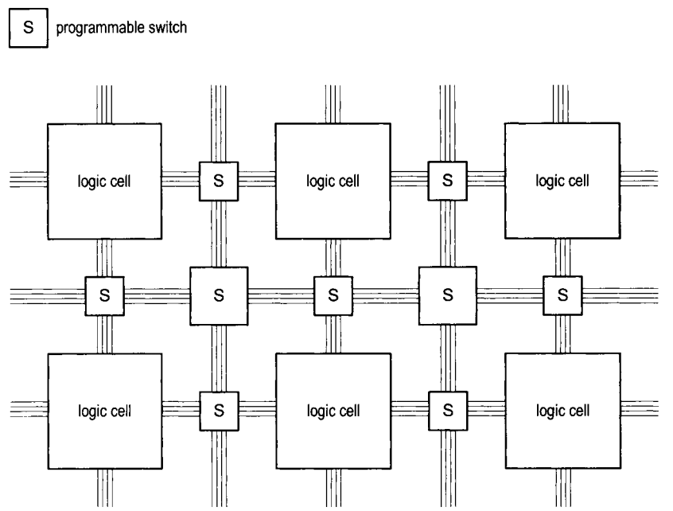
Field-programmable gate array
Image source: Chu. FPGA Prototyping by Verilog Examples

Slide 17
Xilinx Spartan 3E FPGA
A 2D array of configurable logic blocks (CLBs)
Each CLB has four logic/memory slices
Each of the two logic slices (SLICEL) has
Two four-input 16-entry look-up table (LUT) function generators (can store any four-input function)
Two registers
Two multiplexors
Arithmetic logic and carry (two full adders)
Each of the two memory slices (SLICEM) has
Everything of a logic slice
Two 16-bit memory blocks (RAM16)
Two 16-bit shift registers (SRL16)

Slide 18
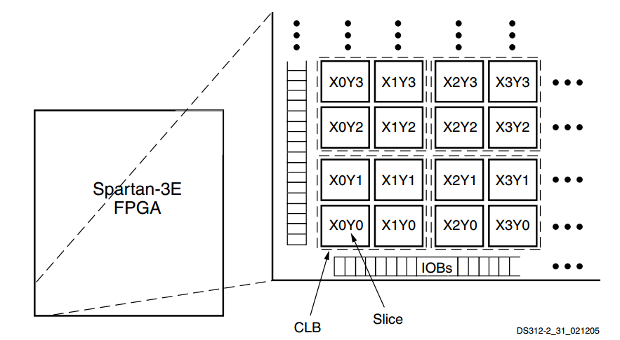
Xilinx Spartan 3E FPGA
Image source: Xilinx

Slide 19
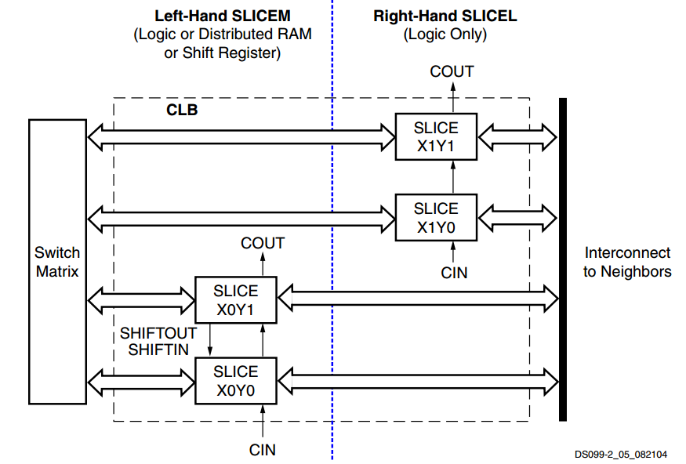
Xilinx Spartan 3E FPGA
Image source: Xilinx

Slide 20
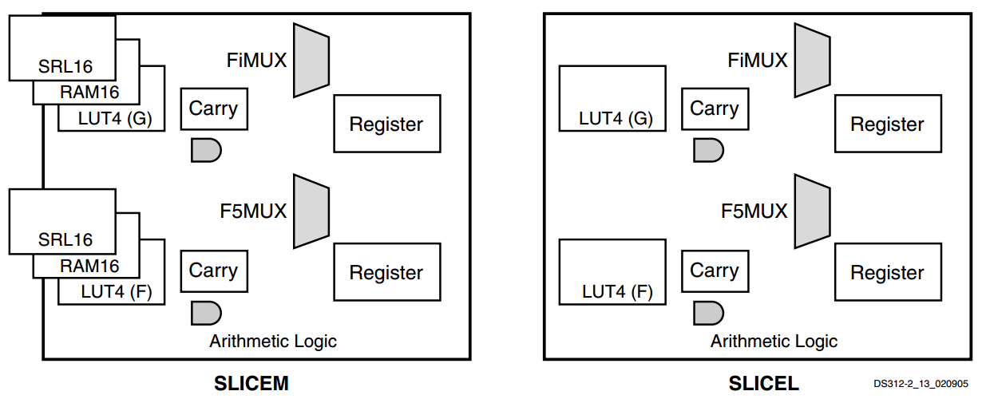
Xilinx Spartan 3E FPGA
Image source: Xilinx

Slide 21
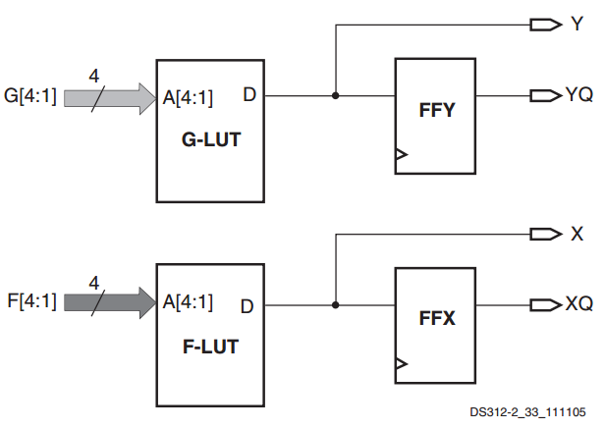
Xilinx Spartan 3E FPGA
Image source: Xilinx

Slide 22
Xilinx Spartan 3E FPGA
A 2D array of configurable logic blocks (CLBs)
I/O blocks (IOB)
Controls I/O between logic/storage and the user interfaces (slide switches, LEDs, LCD, etc.)
Block RAM (random access memory)
Each block can store 18K bits
Multiplier blocks
Each multiplier operates on two 18-bit inputs
Digital clock manager (DCM)
Routes clock throughout the FPGA

Slide 23
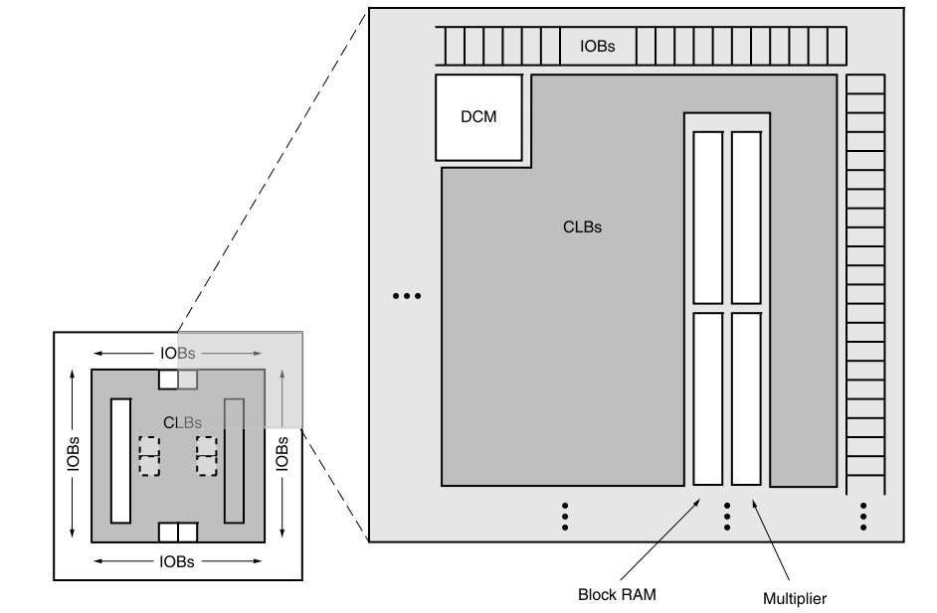
Xilinx Spartan 3E FPGA
Image source: Xilinx

Slide 24
Xilinx Spartan 3E FPGA
Five family members
100K, 250K, 500K, 1200K, and 1600K logic gates
Specs of XC3S500E
500K gates
1164 CLBs (4656 slices); 46 rows, 34 columns
Some CLB rows and columns are taken up by block RAM, multiplier blocks, DCM
360K-bit block RAM (20 RAM blocks, each 18K bits)
20 multiplier blocks
4 DCMs

Slide 25
Asynchronous inputs
Asynchronous inputs to a flip-flop may arrive at any time
Signals coming from outside the computer
It may be necessary to convert it to a synchronous signal that changes with clock
Otherwise cannot be used correctly in computation
Easy way is to pass it through a D flip-flop and use the output of the flip-flop in computation
Called a synchronizer
Output will change with clock edge and the output is synchronous with the clock (after propagation delay)
Fails if the asynchronous input violates setup and hold times

Slide 26
Asynchronous inputs
Synchronizer failure
If the asynchronous input changes within the setup time + hold time window around the clock edge, the flip-flop may go into a metastable state (neither 0 nor 1)
It may take some time for the flip-flop to come out of the metastable state; during this time, the output cannot be used in any computation
Sample output after sufficient delay so that metastability is resolved with high probability
Synchronizer with two D flip-flops in a chain
Works if metastability period is smaller than clock period

Slide 27
Static random access memory
Static random access memory (SRAM)
Name of a technology used for building reasonably large (up to tens of megabytes) and fast memory
Register files are much smaller and faster
Specified as height x width
4M x 8 bits
Address, chip select, output enable, write enable, and write data are inputs
Read data is the output

Slide 28
Static random access memory
Reading from SRAM
Chip select should be asserted for reading from or writing to an SRAM chip
Address is decoded to select a row of SRAM
The data in the row are read out; called a word
The read out word appears on the output when output enable is asserted
Without output enable, the output remains in high impedance state
Allows tying multiple chips’ outputs to the same data bus with the assumption that exactly one chip’s output enable will be asserted at a time

Slide 29
Static random access memory
Writing to SRAM
Chip select should be asserted
Write enable should be asserted
It is a narrow pulse
Data to be written should be on the input data bus
Address is decoded and the data is written to the appropriate row

Slide 30
Static random access memory
Building an SRAM
Address decoder’s outputs are called wordlines
Each wordline “enables” a row for a read or a write
Each bit is implemented as two cross-coupled inverters along with additional logic to “hold” the stored charge
Stored charge (or lack of charge) in a bit represents 1 or 0
Without this additional logic, the stored charge in a HIGH bit may leak out slowly leading to loss of memory
The bits of a column are tied together to a single wire called bitline through a per-bit “switch”

Slide 31
Static random access memory
Building an SRAM
The bitlines connect to the output bus through tri-state switches
The tri-state switches are enabled/disabled by the output enable signal
The write enable pulse can be ANDed with the wordline to act as the “clock” for the row to be written to

Slide 32
Static random access memory
Building an SRAM
Very large SRAMs are not built like one big memory due to the large size of the decoder
Divided into multiple chips that can operate in parallel
Each chip is said to form a bank
4M x 8 could be built as eight 4K x 1024 chips
Entire address is now split into row address and column address
Possible to also operate only a subset of chips by driving the chip select using certain address bits e.g., 4M x 8 could be built using two “ranks” of eight 2K x 1024 chips (could use address MSB as chip select)
SRAM is used to build fast memory (register file, caches, etc.) inside the processor chip

Slide 33
Dynamic random access memory
Dynamic vs. static
Random access memory: can access any location by providing an address
Static if the charge stored in a bit does not have to be “refreshed” periodically
Dynamic if the charge needs to be “refreshed” periodically
DRAM contents can leak away if left to itself for sufficient amount of time
Each bit is implemented as a capacitor which slowly discharges to ground through “sneak” paths
The charge must be refreshed periodically
Refreshing is done in bulk and during refresh data cannot be accessed

Slide 34
Dynamic random access memory
DRAM
Why each bit is just a capacitor (implemented using a single transistor)?
Additional logic reduces the density of storage (number of bits per unit area)
Density is a very important property of DRAM
Refreshing is done row by row
Involves reading out a row and writing the contents back to the row
DRAM is used to build external memory outside the processor chip
Popularly known as the RAM of a computer
Each address refers to a DRAM byte (4 GB DRAM requires a 32-bit address)

Slide 35
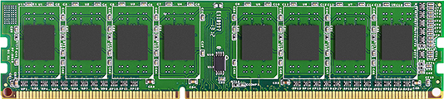
Dynamic random access memory
The RAM of a computer is typically sold as dual-inline memory module (DIMM) cards
Each card has several DRAM chips either on one side or on both sides of the card
Processor chip
(SRAM + logic)
I/O
Devices
DRAM controller
DRAM channels

Slide 36
Dynamic random access memory
Organization of a DRAM chip
Has several banks
Each bank stores a 2D array of bits organized in rows and columns
Doing a read or a write operation on a DRAM chip requires a bank number, a row address, and a column address
The operation is done on the designated bank at the designated row and column
The column address typically selects a few consecutive columns determining the output width or the column width of the chip (x4, x8, x16, etc.)
Example: 512Mbit DRAM chip: 4 banks, 16K rows, 1K columns, x8

Slide 37
Dynamic random access memory
Organization of a DRAM bank
One wordline per row from the row address decoder
The bits in a column are connected to a bitline through a bidirectional switch (also known as a pass transistor or an access transistor)
The switch closes when the corresponding wordline goes HIGH; otherwise it is open

Slide 38
Dynamic random access memory
Read operation to a DRAM bank
The row address is sent first on the address bus along with a row address strobe (RAS) signal
The command bus carries the command (e.g., read or write)
The row address decoder generates the necessary wordline signal
The wordline closes the switch and activates or opens the target row
The bitlines are precharged at the midpoint of HIGH and LOW
When the switch closes, the small difference in bitline voltage is sensed and magnified by an array of sense amplifiers

Slide 39
Dynamic random access memory
Read operation to a DRAM bank
After the row is activated or opened, the entire row is stored in a per-bank area called the row buffer
Next the column address is sent on the address bus along with the column address strobe (CAS)
The column address reads out one column worth (same as output width) of data and sends that on the DRAM channel
It is possible to read out N consecutive columns from the row buffer without sending a new column address every time (except the first time), where N is the burst length of the DRAM module

Slide 40
Dynamic random access memory
Read operation to a DRAM bank
It is much faster to do CAS operations from the row buffer compared to precharging a bank and activating the row over and over
Better to do all reads going to the same row of a bank first before changing row in that bank
Writes are similar, but requires data to be written
A double data rate (DDR) DRAM can transfer the data on both clock edges
Two data tranfers in a cycle; hence called double data rate

Slide 41
Dynamic random access memory
Organization of a DIMM card
A bidirectional channel connects to a DIMM card for carrying data between the card and the memory controller (same as DRAM controller)
Channel width is usually governed by standard interfaces
JEDEC standards are the only accepted standard
Joint Electron Device Engineering Council
Channel width is usually 64 or 128 bits
In addition to the data channel, there is an address bus and a command bus
Unidirectional from memory controller to DIMM

Slide 42
Dynamic random access memory
Organization of a DIMM card
The chips in a DIMM card are divided into several ranks
A read or a write command is sent to all the chips in a rank
The chip selects of the chips in that rank are made HIGH
The memory controller sends the same bank number, row number, and column number to all chips in the target rank
The corresponding bank in each chip provide an output
For example, with 64-bit channels and x4 chips, 16 chips constitute a rank

Slide 43
Dynamic random access memory
Utility of burst length (BL)
Typically a large chunk of data is fetched together by the processor from DRAM
Tries to exploit spatial locality
For example, 64 bytes in a large number of processors
If BL is 8, an x4 DDR chip will generate four bits of output every half cycle after the first four-bit output
Takes four cycles to complete the burst
A rank of 16 chips will generate 64-byte output in four cycles after the first 64 bits
The first 64-bit output on a 64-bit channel may have a variable latency

Slide 44
Dynamic random access memory
Variable latency of first element of a burst
Read to already open/activated row: fastest
Only need to send CAS with column address
Known as row hit (10 to 20 ns)
Read to a bank that has no open/active row
Need to activate row and then send CAS
Roughly 2x latency compared to fastest
Known as row miss
Read to a bank that has a different open row
Need to close the row (precharge the bank)
Need to activate new row and then send CAS
Roughly 3x latency compared to fastest
Known as row conflict

Slide 45
Dynamic random access memory
After reading out the data from rank
Transfer over the channel to the memory controller; adds more cycles to overall latency
Transfer from memory controller to processor cache (an on-chip fast SRAM storage); even more cycles
Stored for quick reuse in future
Address decoding in memory controller
The processor sends read and write commands to the memory controller along with an address
Writes need to carry data also
The memory controller breaks this address down into channel, rank, bank, row, column

Slide 46
Dynamic random access memory
Path between processor and DRAM
Let us assume that the processor logic can request 32 bits of data at a time from the on-chip SRAM cache
Referred to as the processor datapath width
For example, for adding two 32-bit numbers, the processor will make two requests one after another to the cache
Assume that the address width is 32 bits
Need not be same as the datapath width and can be more or less
Determines the maximum amount of DRAM that can be installed
With 32-bit address, the maximum DRAM capacity is 4 GB

Slide 47

Dynamic random access memory
Path between processor and DRAM
Let us assume that the SRAM cache fetches 64 bytes of data at a time from DRAM
Beneficial because of spatial locality
Processor logic
DIMM card
32-bit
address
bus
Command
bus (read/
write)
ACT/
PRE/CAS
64-bit
data
ch.
32-bit
data
bus
Addr.
bus
64-byte data bus
SRAM cache
DRAM
Controller
32-bit addr. bus
Command bus
Read/Write

Slide 48
Dynamic random access memory
Path between processor and DRAM
DRAM controller extracts row, rank, bank, column, channel numbers from the address it receives from the SRAM cache
If a new row needs to be activated, the command is ACT (or RAS) and the address bus carries the rank, bank, row numbers
If a bank needs to be precharged, the command is PRE and the address bus carries the rank and bank numbers
If a column read/write needs to be done, the command is CAS and the address bus carries the rank, bank, and column numbers

Slide 49
Dynamic random access memory
Address decoding in DRAM controller
Each address corresponds to a DRAM byte
DRAM controller receives an address from the SRAM cache and fetches the 64-byte chunk from DRAM containing that address
Achieved by programming the BL to eight
Within a bank, the column number is automatically incremented to burst out eight 64-bit chunks
Usually the channel number is decoded from the bits right after the least significant six bits of the address covering 64 bytes of data
Ensures parallelism across channels for consecutive 64-byte requests
Ensures that a request is never split across channels

Slide 50
Dynamic random access memory
Address decoding in DRAM controller
Example decoding (assuming 64-bit channels):
Interface to DIMM is eight-byte wide (64-bit ch.)
Lower three bits of the address must be zero to make it aligned to eight bytes (a 128-bit ch. has 4 bits zero)
Example: 4 GB DRAM, two 64-bit channels, 1Gb x4 DRAM chips, 32K rows, four banks, BL=8
32-bit address
2 GB per channel, which means 16 chips per channel
One rank per channel, 2K columns (each 4 bits)
Column-low=3 bits, Channel=1 bit, Column-high=8 bits, Bank=2 bits, Rank=0 bit, Row=15 bits
Column-low is incremented internally in the DRAM chips to cover eight bursts
Row
Rank
Bank
Column-high
Channel
Column-low
000

Slide 51
Dynamic random access memory
Error detection and correction in DRAM
Densely packed DRAM bits can suffer from flips (0 becoming 1 or 1 becoming 0) for certain reasons
For correct computation, it is important to detect such errors and possibly abort computation if the error cannot be corrected; need error correction code (ECC)
Simple parity code can detect one-bit errors, but cannot correct any error
Parity = Bitwise xor of data (no. of 1’s odd or even?)
One parity bit is stored per DRAM byte: each DRAM address refers to nine bits of data+ECC
Complex codes are needed to correct errors
SECDED (single error correct double error detect) codes are very popular

Slide 52
Finite state machines (FSMs)
Every digital design is a marriage of combinational logic and sequential logic
Combinational logic does the computation
Sequential logic implements the state/storage elements
Any realizable design would have a finite number of state elements
This leads to a finite number of states e.g., with n state elements (each storing one bit), 2^{n} different states are possible
A digital design with finite number of states is called a finite state machine (FSM)
Every realizable digital design is an FSM

Slide 53
Finite state machines (FSMs)
Each state can have an output value attached to it
In a four-state FSM, these values could be 00, 01, 10, 11
At any point in time, the FSM is in one of its possible states
The state can change based on the input and the combinational logic
For example, in a four-state FSM, the current state 10 can change to 11 on an input 0; the current state 10 can change to 00 on an input 1

Slide 54
Finite state machines (FSMs)
Next state function
A function that defines the state transitions when inputs are applied to the FSM
In a four-state FSM, the function defines the new state when the current state receives a 0 or a 1 input; F: S x I → S
Eight possible entries in the function: F(S0, 0), F(S0, 1), F(S1, 0), F(S1, 1), F(S2, 0), F(S2, 1), F(S3, 0), F(S3, 1) where S0, S1, S2, S3 are the four states
We will be interested only in synchronous FSMs where the state changes take place on clock edges (after propagation delay)
Clock is an implicit input to all FSMs of our interest

Slide 55
Finite state machines (FSMs)
Next state function: an example
F(S0, 0) = S0, F(S0, 1) = S1, F(S1, 0) = S1, F(S1, 1) = S2, F(S2, 0) = S2, F(S2, 1) = S3, F(S3, 0) = S3, F(S3, 1) = S0
Usually a state diagram is used to represent the next state function
0
S0
1
S1
0
1
1
0
S3
1
S2
0

Slide 56
Finite state machines (FSMs)
Output function
The FSM can output a value based on its current state and input; G: S x I → N
In a four-state FSM, there are eight possible output function entries
Example: G(S0, 0) = red, G(S0, 1) = green, G(S1, 0) = blue, G(S1, 1) = black, G(S2, 0) = red, G(S2, 1) = green, G(S3, 0) = orange, G(S3, 1) = brown
If the output function depends only on current state, the FSM is called a Moore machine
If the output function depends only on current state and input, the FSM is called a Mealy machine

Slide 57
Finite state machines (FSMs)
Output
Output function
(Combinational logic)
Next state function
(Combinational logic)
clock
State registers
Input

Slide 58
Finite state machines (FSMs)
Two-bit state: (x, y); four states: 00, 01, 10, 11
Suppose f(0) = 1 and f(1) = 0
initial
0
1
initial
f
y
0
1
1
0
1
0
1
x
clk
00
01
1
11
1
10

Slide 59
Finite state machines (FSMs)
Two-bit state: (x, y); four states: 00, 01, 10, 11
Suppose f(0) = 1 and f(1) = 0
f
y
x
clk
start
0
00
01
0
0
1
1
start
0
11
10
1
1

Slide 60
Finite state machines (FSMs)
f
y
x
clk
If the environment is sampling the output only at y, the
output function depends only on the current state and
is equal to the y bit of the state

Slide 61
Finite state machine design
Step#1: derive the FSM from problem description
This is usually the challenging step
Step#2: decide the state elements
Step#3: design the combinational logic for the next state function
Step#4: design the combinational logic for the output function

Slide 62
Finite state machine design
Example
We would like to design a digital logic that detects if the input pattern is alternating i.e., the input is 101010… or 010101…
S0
x=1
S1
x=0,1
x=0
x=1
x=0
x=0
Start
Reject
x=1
x=0
x=0
x=1
T0
T1
x=1

Slide 63
Finite state machine design
Example: detecting alternating input patterns
Output of Reject state is 0 and of all other states is 1
Could drive an LED with the output and the LED will keep glowing as long as the input alternates
Empty and single-bit inputs are assumed to be alternating
Six states require three state bits
Call these a, b, c. Assume following state encoding:
Start = 000 or ~a & ~b & ~c, S0 = 001 or ~a & ~b & c, S1 = 010 or ~a & b & ~c, T0 = 011 or ~a & b & c, T1 = 100 or a & ~b & ~c, Reject = 101 or a & ~b & c
Output = ~Reject = ~a | b | ~c
Includes states 110 and 111 also, but that is not wrong

Slide 64
Finite state machine design
Example: detecting alternating input patterns
Next step is to design the next state function
Purely combination logic
Can be designed by preparing a truth table where the inputs are current states and x and output is the next state
The goal is to write down three combinational logic formulas that determine the D inputs to the three flip-flops storing a, b, c

Slide 65
Finite state machine design
Example: detecting alternating input patterns
Few truth table entries (da, db, dc are the D inputs of the a, b, c flip-flops)
a,b,c,x=0,0,0,0 then da,db,dc=0,0,1 (this is S0)
a,b,c,x=0,0,0,1 then da,db,dc=0,1,1 (this is T0)
S0
x=1
S1
x=0,1
x=0
x=1
x=0
x=0
Start
Reject
x=1
x=0
x=0
x=1
T0
T1
x=1

Slide 66
Finite state machine design
Example: detecting alternating input patterns
Next state function’s truth table may not have all entries fully specified
In this example, the following four entries (out of sixteen) will not have any next state specified
a,b,c,x=1,1,0,0
a,b,c,x=1,1,0,1
a,b,c,x=1,1,1,0
a,b,c,x=1,1,1,1
da,db,dc can be taken as anything (don’t cares) in these cases to simplify the combinational logic

Slide 67
Finite state machine design
Example: detecting alternating input patterns
a,b,c,x=0,0,0,0 da,db,dc=0,0,1 (this is S0)
a,b,c,x=0,0,0,1 da,db,dc=0,1,1 (this is T0)
a,b,c,x=0,0,1,0 da,db,dc=1,0,1 (this is Reject)
a,b,c,x=0,0,1,1 da,db,dc=0,1,0 (this is S1)
a,b,c,x=0,1,0,0 da,db,dc=0,0,1 (this is S0)
a,b,c,x=0,1,0,1 da,db,dc=1,0,1 (this is Reject)
a,b,c,x=0,1,1,0 da,db,dc=1,0,0 (this is T1)
a,b,c,x=0,1,1,1 da,db,dc=1,0,1 (this is Reject)
a,b,c,x=1,0,0,0 da,db,dc=1,0,1 (this is Reject)
a,b,c,x=1,0,0,1 da,db,dc=0,1,1 (this is T0)
a,b,c,x=1,0,1,0 da,db,dc=1,0,1 (this is Reject)
a,b,c,x=1,0,1,1 da,db,dc=1,0,1 (this is Reject)

Slide 68
Finite state machine design
Example: detecting alternating input patterns
Next state function
da = (~x & (c | a)) | (a & (b | c)) | (b & x)
db = (a & b) | (~a & ~b & x) | (a & ~c & x)
dc = ~c | a | (b & x) | (~b & c & ~x)
Possible implementations of the next state combinational logic
PLA (requires deriving the formulas)
ROM (requires only the truth table): 12 rows x 3 bits
If the next state function is implemented with a ROM, we can store the output function also in ROM and remove the output function logic
One extra column of bits in the ROM for this example

Slide 69
Finite state machine design
Output (can drive an LED)
~a | b | ~c
a, b, c
Next state function
(PLA or ROM)
da
db
dc
a, b, c
clock
a
b
c
x
Input x

Slide 70
Finite state machine design
The output function, the next state function, and the states constitute the control unit of the FSM
The outputs of the FSM may drive the external datapaths
In this example, the datapath is as simple as a discrete LED
In more complex examples, the FSM outputs can be used as inputs to other computations

Slide 71
Finite state machine design
Implementing next state function using a sequencer
With an increasing number of states, it becomes difficult to design the next state function using PLA or ROM
In many large FSMs, the states are often visited sequentially
Appropriate state assignment can make it even more often
In such FSMs, the next state function can be implemented using a simple counter with the option of “branching out” occasionally
Branching happens when the next state is not current state + 1 or there are multiple possible next states

Slide 72
Finite state machine design
Outputs
PLA or ROM
Branch control
State registers
clock
Increment
State selection logic
Input

Slide 73
Finite state machine design
Implementing next state function using a sequencer
The PLA or the ROM now implements the output function and the branch control
The non-consecutive next states are handled by reading out the next state from separate ROMs in such cases
These are called dispatch ROMs
One dispatch ROM for each non-sequential case or all dispatch ROMs can be fused into one dispatch ROM
Input decides the row of the dispatch ROMs

Slide 74
Finite state machine design
Outputs
PLA or ROM
Branch control
State registers
clock
Increment
State selection multiplexor
Dispatch ROMs
Input

Slide 75
Finite state machine design
Implementing next state function using a sequencer
For the states, where the next state is just the incremented state, the branch control is stored as zero in the ROM
Ensures that the incremented state will be selected by the multiplexor
For each of the remaining states, the branch control specifies which dispatch ROM’s output should be selected
Each dispatch ROM is indexed by the input and provides one output
The ROM that stores the output function and the branch control is much smaller in width now

Slide 76
Finite state machine design
Implementing next state function using a sequencer
Each entry of the ROM that implements the outputs and the branch control is often seen as storing the instruction for controlling the next state and the output
Referred to as a microcode ROM
Each ROM entry is referred to as a microinstruction
The state registers together form the microinstruction address or the microprogram counter which determines the ROM entry of the next microinstruction
This style of FSM control implementation is known as microprogrammed control unit design

